Slide 1
CS 61C: Great Ideas in Computer Architecture (Machine Structures) Thread-Level Parallelism (TLP) and OpenMP
Instructors:
Krste Asanovic & Vladimir Stojanovic
http://inst.eecs.berkeley.edu/~cs61c/

Slide 2
Review
Sequential software is slow software
SIMD and MIMD only path to higher performance
Multithreading increases utilization, Multicore more processors (MIMD)
Synchronization
atomic read-modify-write using load-linked/store-conditional
OpenMP as simple parallel extension to C
Threads, Parallel for, private, critical sections, …
≈ C: small so easy to learn, but not very high level and it’s easy to get into trouble

Slide 3
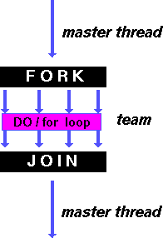
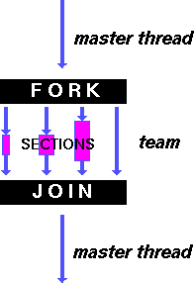
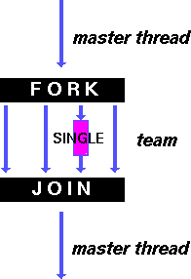
OpenMP Directives (Work-Sharing)
These are defined within a parallel section
Shares iterations of a loop across the threads
Each section is executed by a separate thread
Serializes the execution of a thread
Notes:
A work-sharing construct divides the execution of the enclosed code region among the members of the team that encounter it.

Slide 4
Parallel Statement Shorthand
#pragma omp parallel
{
#pragma omp for
for(i=0;i<len;i++) { … }
}
can be shortened to:
#pragma omp parallel for
for(i=0;i<len;i++) { … }
Also works for sections
This is the only directive in the parallel section

Slide 5
Building Block: for loop
for (i=0; i<max; i++) zero[i] = 0;
Break for loop into chunks, and allocate each chunk to a separate thread
e.g. if max = 100 with 2 threads: assign 0-49 to thread 0, and 50-99 to thread 1
Must have relatively simple “shape” for an OpenMP-aware compiler to be able to parallelize it
Necessary for the run-time system to be able to determine how many of the loop iterations to assign to each thread
No premature exits from the loop allowed
i.e. No break, return, exit, goto statements
In general, don’t jump outside of any pragma block
Notes:
“Shape” restrictions: The FOR loop can not be a DO WHILE loop, or a loop without loop control. Also, the loop iteration variable must be an integer and the loop control parameters must be the same for all threads.

Slide 6
Parallel for pragma
#pragma omp parallel for
for (i=0; i<max; i++) zero[i] = 0;
Master thread creates additional threads, each with a separate execution context
All variables declared outside for loop are shared by default, except for loop index which is private per thread (Why?)
Implicit synchronization at end of for loop
Divide index regions sequentially per thread
Thread 0 gets 0, 1, …, (max/n)-1;
Thread 1 gets max/n, max/n+1, …, 2*(max/n)-1
Why?

Slide 7
OpenMP Timing
Elapsed wall clock time:
double omp_get_wtime(void);
Returns elapsed wall clock time in seconds
Time is measured per thread, no guarantee can be made that two distinct threads measure the same time
Time is measured from “some time in the past,” so subtract results of two calls to omp_get_wtime to get elapsed time

Slide 8
Matrix Multiply in OpenMP
start_time = omp_get_wtime();
#pragma omp parallel for private(tmp, i, j, k)
for (i=0; i<Mdim; i++){
for (j=0; j<Ndim; j++){
tmp = 0.0;
for( k=0; k<Pdim; k++){
/* C(i,j) = sum(over k) A(i,k) * B(k,j)*/
tmp += *(A+(i*Pdim+k)) * *(B+(k*Ndim+j));
}
*(C+(i*Ndim+j)) = tmp;
}
}
run_time = omp_get_wtime() - start_time;
Outer loop spread across N threads; inner loops inside a single thread

Slide 9
Notes on Matrix Multiply Example
More performance optimizations available:
Higher compiler optimization (-O2, -O3) to reduce number of instructions executed
Cache blocking to improve memory performance
Using SIMD SSE instructions to raise floating point computation rate (DLP)

Slide 10
Simple Multiprocessor
Processor 0
Control
Memory
Processor 0 Memory Accesses
Input
Datapath
PC
Registers
(ALU)
Bytes
Processor 1
Control
Processor 1 Memory Accesses
Datapath
Output
PC
Registers
(ALU)
I/O-Memory Interfaces

Slide 11
Multiprocessor Caches
Memory is a performance bottleneck even with one processor
Use caches to reduce bandwidth demands on main memory
Each core has a local private cache holding data it has accessed recently
Only cache misses have to access the shared common memory
Processor
Processor
Processor
Cache
Cache
Cache
Interconnection Network
Memory
I/O
Notes:
Power has become the overriding issue for both data centers and microprocessors. Power efficiency has joined scalable performance making the case for multiprocessors. Multiprocessors also improve availability.

Slide 12
Shared Memory and Caches
What if?
Processors 1 and 2 read Memory[1000] (value 20)
0
1
2
Processor
Processor
1000
Processor
1000
Cache
1000
1000
Cache
Cache
Interconnection Network
20
Memory
20
I/O

Slide 13
Shared Memory and Caches
Now:
Processor 0 writes Memory[1000] with 40
0
1
2
1000
Processor
Processor
Processor
1000 40
1000 20
1000 20
Cache
Cache
Cache
Interconnection Network
1000 40
Memory
I/O
Problem?

Slide 14
Keeping Multiple Caches Coherent
Architect’s job: shared memory => keep cache values coherent
Idea: When any processor has cache miss or writes, notify other processors via interconnection network
If only reading, many processors can have copies
If a processor writes, invalidate any other copies
Write transactions from one processor “snoop” tags of other caches using common interconnect
Invalidate any “hits” to same address in other caches
If hit is to dirty line, other cache has to write back first!

Slide 15
Shared Memory and Caches
Example, now with cache coherence
Processors 1 and 2 read Memory[1000]
Processor 0 writes Memory[1000] with 40
0
Processor 0
Write
Invalidates
Other Copies
Processor
1
2
1000
Processor
Processor
1000 40
1000 20
1000 20
Cache
Cache
Cache
Interconnection Network
1000 40
Memory
I/O

Slide 16
Clickers/Peer Instruction: Which statement is true?
A: Using write-through caches removes the need for cache coherence
B: Every processor store instruction must check contents of other caches
C: Most processor load and store accesses only need to check in local private cache
D: Only one processor can cache any memory location at one time

Slide 17
Administrivia
MT2 is Thursday, April 9th:
Covers lecture material up till 3/31 lecture
TWO cheat sheets, 8.5”x11”

Slide 18
Cache Coherency Tracked by Block
Processor 0
Processor 1
Cache 0
Cache 1
4000
4000
4004
4008
4012
4016
4028
Tag
32-Byte Data Block
Memory
Suppose block size is 32 bytes
Suppose Processor 0 reading and writing variable X, Processor 1 reading and writing variable Y
Suppose in X location 4000, Y in 4012
What will happen?

Slide 19
Coherency Tracked by Cache Line
Block ping-pongs between two caches even though processors are accessing disjoint variables
Effect called false sharing
How can you prevent it?

Slide 20
Review: Understanding Cache Misses: The 3Cs
Compulsory (cold start or process migration, 1st reference):
First access to block, impossible to avoid; small effect for long-running programs
Solution: increase block size (increases miss penalty; very large blocks could increase miss rate)
Capacity (not compulsory and…)
Cache cannot contain all blocks accessed by the program even with perfect replacement policy in fully associative cache
Solution: increase cache size (may increase access time)
Conflict (not compulsory or capacity and…):
Multiple memory locations map to the same cache location
Solution 1: increase cache size
Solution 2: increase associativity (may increase access time)
Solution 3: improve replacement policy, e.g.. LRU
Notes:
(Capacity miss) That is the cache misses are due to the fact that the cache is simply not large enough to contain all the blocks that are accessed by the program.
The solution to reduce the Capacity miss rate is simple: increase the cache size.
Here is a summary of other types of cache miss we talked about.
First is the Compulsory misses. These are the misses that we cannot avoid. They are caused when we first start the program.
Then we talked about the conflict misses. They are the misses that caused by multiple memory locations being mapped to the same cache location.
There are two solutions to reduce conflict misses. The first one is, once again, increase the cache size. The second one is to increase the associativity.
For example, say using a 2-way set associative cache instead of directed mapped cache.
But keep in mind that cache miss rate is only one part of the equation. You also have to worry about cache access time and miss penalty. Do NOT optimize miss rate alone.
Finally, there is another source of cache miss we will not cover today. Those are referred to as invalidation misses caused by another process, such as IO , update the main memory so you have to flush the cache to avoid inconsistency between memory and cache.
+2 = 43 min. (Y:23)

Slide 21
How to Calculate 3C’s using Cache Simulator
Compulsory: set cache size to infinity and fully associative, and count number of misses
Capacity: reduce cache size from infinity, usually in powers of 2, implement optimal replacement, and count misses for each reduction in size
16 MB, 8 MB, 4 MB, … 128 KB, 64 KB, 16 KB
Conflict: Change from fully associative to n-way set associative while counting misses
Fully associative, 16-way, 8-way, 4-way, 2-way, 1-way

Slide 22
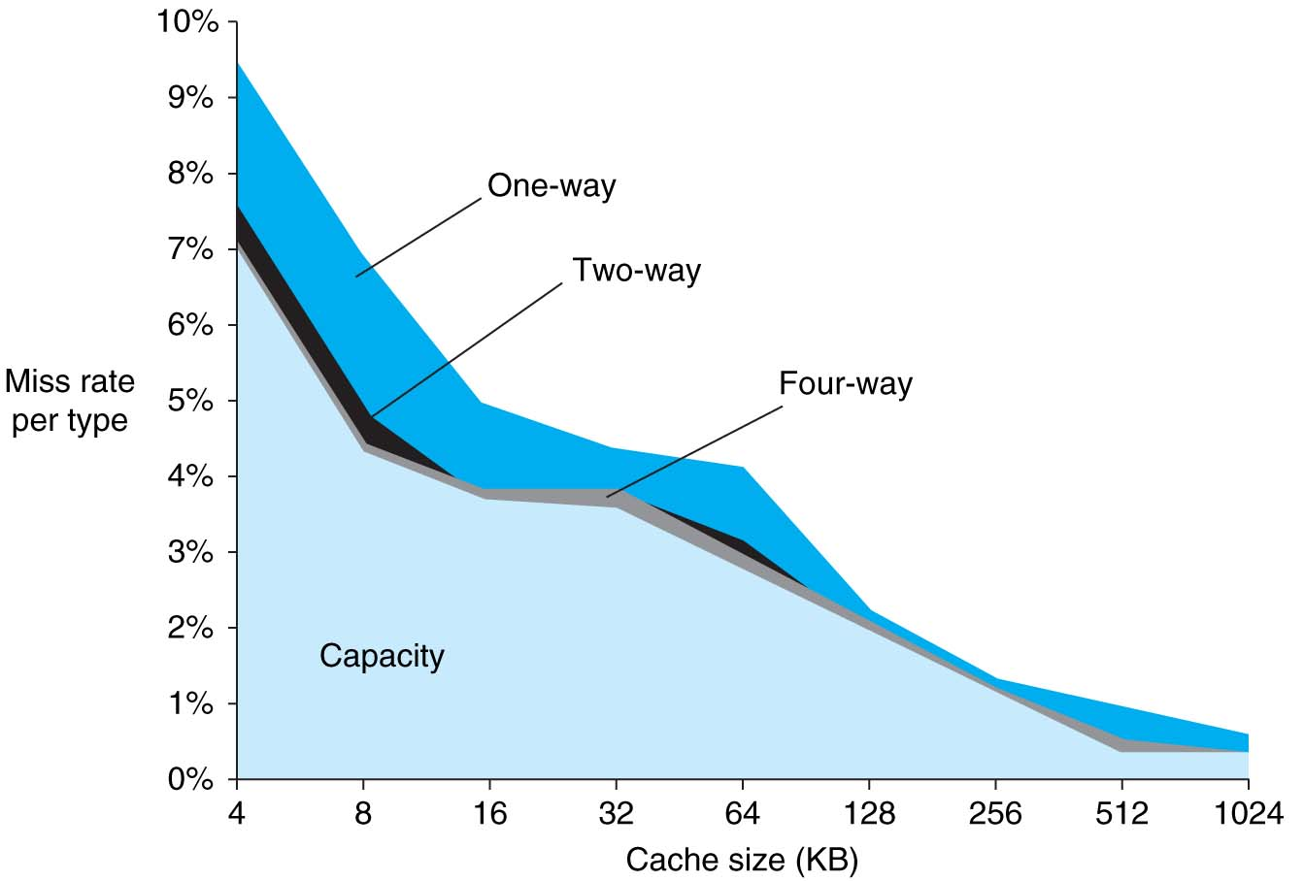
3Cs Analysis
Three sources of misses (SPEC2000 integer and floating-point benchmarks)
Compulsory misses 0.006%; not visible
Capacity misses, function of cache size
Conflict portion depends on associativity and cache size

Slide 23
Fourth “C” of Cache Misses: Coherence Misses
Misses caused by coherence traffic with other processor
Also known as communication misses because represents data moving between processors working together on a parallel program
For some parallel programs, coherence misses can dominate total misses

Slide 24
π
3. 141592653589793238462643383279502884197169399375105820974944592307816406286208998628034825342117067982148086513282306647093844609550582231725359408128481117450284102…

Slide 25
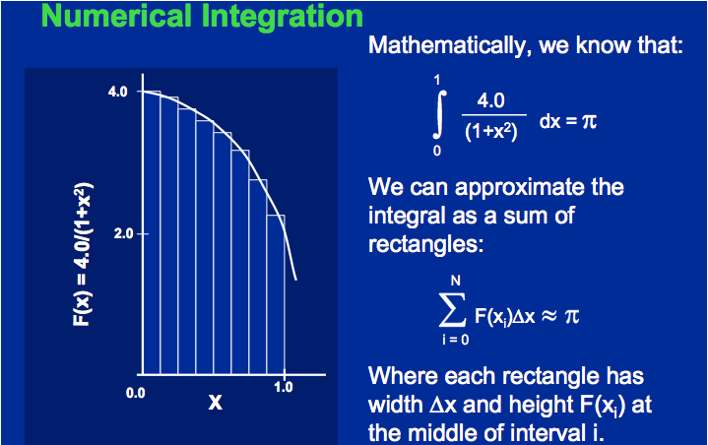
Calculating π

Slide 26
Sequential Calculation of π in C
#include <stdio.h>/* Serial Code */
static long num_steps = 100000; double step;
void main ()
{ int i; double x, pi, sum = 0.0;
step = 1.0/(double) num_steps;
for (i=1;i<= num_steps; i++){
x = (i-0.5)*step;
sum = sum + 4.0/(1.0+x*x);
}
pi = sum/num_steps;
printf ("pi = %6.12f\n", pi);
}

Slide 27
OpenMP Version (with bug)
#include <omp.h>
static long num_steps = 100000; double step;
#define NUM_THREADS 2
void main ()
{ int i; double x, pi, sum[NUM_THREADS];
step = 1.0/(double) num_steps;
#pragma omp parallel private (x)
{ int id = omp_get_thread_num();
for (i=id, sum[id]=0.0; i< num_steps; i=i+NUM_THREADS)
{
x = (i+0.5)*step;
sum[id] += 4.0/(1.0+x*x);
}
}
for(i=0, pi=0.0; i<NUM_THREADS; i++)
pi += sum[i] ;
printf ("pi = %6.12f\n", pi / num_steps);
}

Slide 28
Experiment
Run with NUM_THREADS = 1 multiple times
Run with NUM_THREADS = 2 multiple times
What happens?

Slide 29
OpenMP Version (with bug)
#include <omp.h>
static long num_steps = 100000; double step;
#define NUM_THREADS 2
void main ()
{ int i; double x, pi, sum[NUM_THREADS];
step = 1.0/(double) num_steps;
#pragma omp parallel private (x)
{ int id = omp_get_thread_num();
for (i=id, sum[id]=0.0; i< num_steps; i=i+NUM_THREADS)
{
x = (i+0.5)*step;
sum[id] += 4.0/(1.0+x*x);
}
}
for(i=0, pi=0.0; i<NUM_THREADS; i++)
pi += sum[i] ;
printf ("pi = %6.12f\n", pi/num_steps);
}
Note: loop index variable i is shared between threads

Slide 30
OpenMP Version 2 (with bug)
#include <omp.h>
static long num_steps = 100000; double step;
#define NUM_THREADS 2
void main ()
{ int i; double x, sum, pi=0.0;
step = 1.0/(double) num_steps;
#pragma omp parallel private (x, sum)
{ int id = omp_get_thread_num();
for (i=id, sum=0.0; i< num_steps; i=i+NUM_THREADS)
{
x = (i+0.5)*step;
sum += 4.0/(1.0+x*x);
}
#pragma omp critical
pi += sum;
}
printf ("pi = %6.12f\n”,pi/num_steps);
}

Slide 31
OpenMP Reduction
Reduction: specifies that 1 or more variables that are private to each thread are subject of reduction operation at end of parallel region: reduction(operation:var) where
Operation: operator to perform on the variables (var) at the end of the parallel region
Var: One or more variables on which to perform scalar reduction.
#pragma omp for reduction(+ : nSum) for (i = START ; i <= END ; ++i) nSum += i;

Slide 32
OpenMP Reduction Version
#include <omp.h>
#include <stdio.h>
/static long num_steps = 100000;
double step;
void main ()
{ int i; double x, pi, sum = 0.0;
step = 1.0/(double) num_steps;
#pragma omp parallel for private(x) reduction(+:sum)
for (i=1; i<= num_steps; i++){
x = (i-0.5)*step;
sum = sum + 4.0/(1.0+x*x);
}
pi = sum / num_steps;
printf ("pi = %6.8f\n", pi);
}
Note: Don’t have to declare for loop index variable i private, since that is default

Slide 33
And in Conclusion, …
Multiprocessor/Multicore uses Shared Memory
Cache coherency implements shared memory even with multiple copies in multiple caches
False sharing a concern; watch block size!
OpenMP as simple parallel extension to C
Threads, Parallel for, private, critical sections, reductions …
≈ C: small so easy to learn, but not very high level and it’s easy to get into trouble

